Slide 1
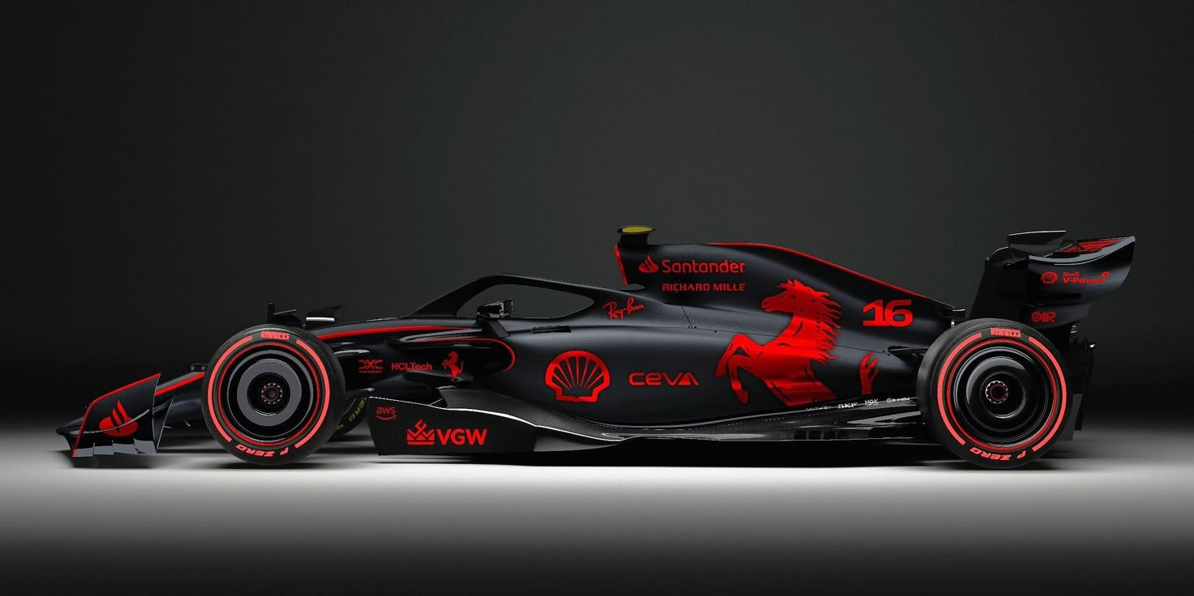
Introduction to Formula 1
Formula 1: The Pinnacle of Motorsports
Speed ⁘Technology ⁘Strategy
Formula 1 (F1) is the highest class of international racing for single-seater cars.
Governed by FIA (Fédération Internationale de l’Automobile).
Involves Grand Prix races held worldwide.

Slide 2
Introduction to Formula 1
Formula 1 (F1) is the highest class of international racing for single-seater cars.
Governed by FIA (Fédération Internationale de l’Automobile).
Involves Grand Prix races held worldwide.

Slide 3
Introduction to Formula 1
History of Formula 1
Formula 1 (F1) is the highest class of international racing for single-seater cars.
Governed by FIA (Fédération Internationale de l’Automobile).
Involves Grand Prix races held worldwide.
First F1 World Championship held in 1950 at Silverstone, UK.
Evolved into a global sport with millions of fans.
Famous teams: Ferrari, McLaren, Mercedes, Red Bull.

Slide 4
Introduction to Formula 1
History of Formula 1
Technology in Formula 1
Formula 1 (F1) is the highest class of international racing for single-seater cars.
Governed by FIA (Fédération Internationale de l’Automobile).
Involves Grand Prix races held worldwide.
First F1 World Championship held in 1950 at Silverstone, UK.
Evolved into a global sport with millions of fans.
Famous teams: Ferrari, McLaren, Mercedes, Red Bull.
Advanced aerodynamics and car design.
Hybrid power units with energy recovery systems.
Safety innovations like the Halo device.

Slide 5
Conclusion
Introduction to Formula 1
History of Formula 1
Technology in Formula 1
Formula 1 (F1) is the highest class of international racing for single-seater cars.
Governed by FIA (Fédération Internationale de l’Automobile).
Involves Grand Prix races held worldwide.
First F1 World Championship held in 1950 at Silverstone, UK.
Evolved into a global sport with millions of fans.
Famous teams: Ferrari, McLaren, Mercedes, Red Bull.
Advanced aerodynamics and car design.
Hybrid power units with energy recovery systems.
Safety innovations like the Halo device.
Formula 1 is not just about speed but also strategy, teamwork, and technology.
It continues to push boundaries in engineering and sports.
The future of F1 includes sustainability and greener technology.

